Slide 1
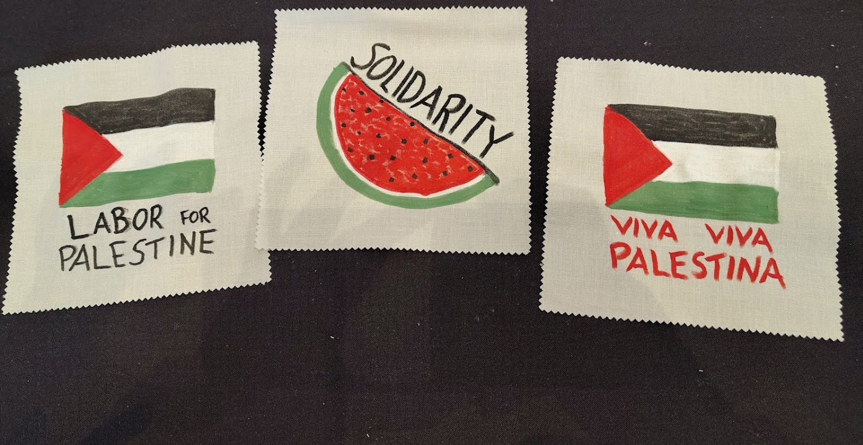
2026 AFL-CIO Dr. Martin Luther King Jr.
Civil & Human Rights Conference
Report Back
Johanne Rokholt, USW Local 9562

Slide 2

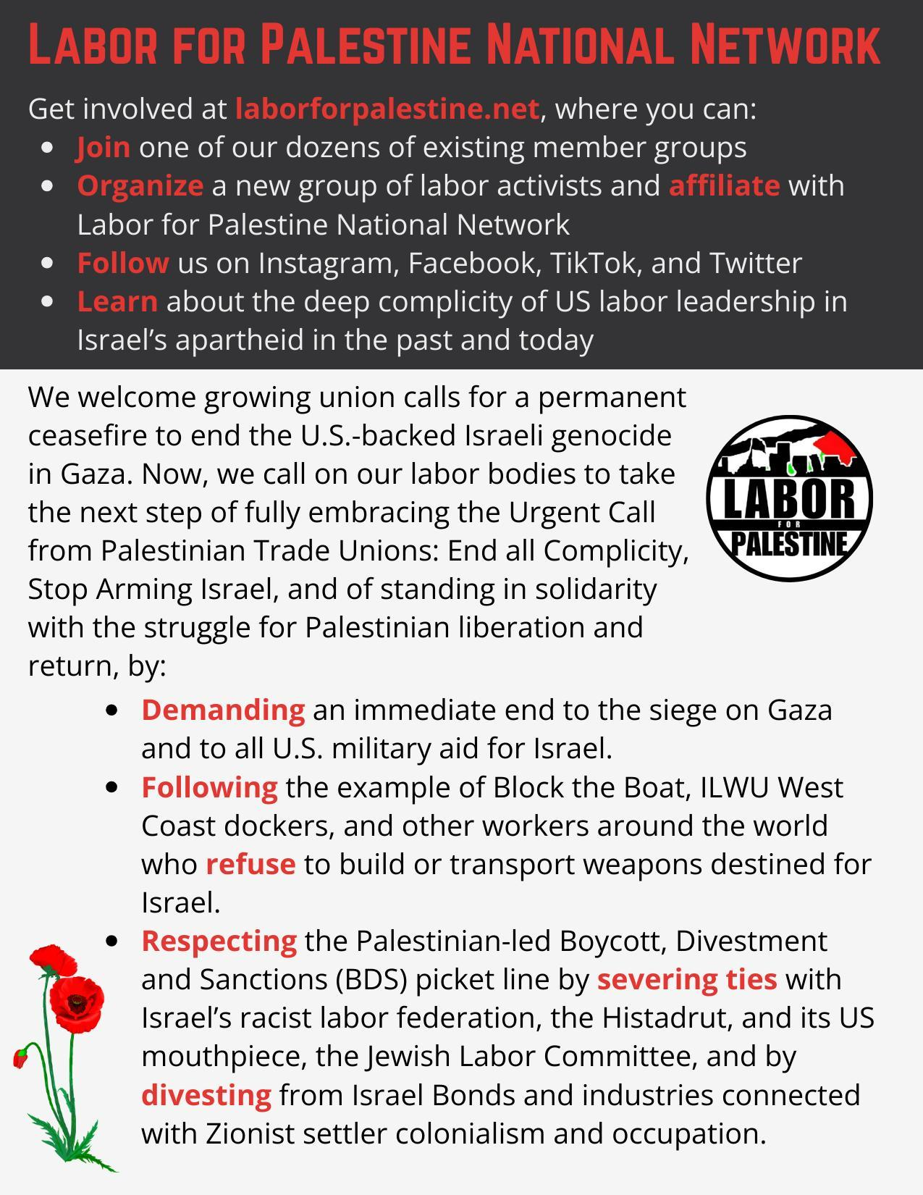
Notes:
Thanks to Cross, Jack, and Michael Letwin for most of these words!

Slide 3
Key Takeaways
What worked
Bring like-minded folks for solidarity and sharing the load
Talk to people who are milling around and waiting or crafting
Start conversations by offering button, then follow up with information and requests
Talk to both rank and file members and people in power
Flyer
Main argument: parallels to apartheid, and what unions did to stop that
What could have been better
Study ahead to recognize the people in power who will be present, so you don’t miss opportunities to talk to them
Come early to everything
Have a clear and easy path for how to get involved:
  Printout of list of member groups
  Contact for each member group?
  Steps for starting new group
  Ideas for action items new groups can start with

