Slide 1
Texas Labor & Palestine
January 2024

Slide 2
WHO ARE WE?
The Palestinian Youth Movement (PYM) is a independent, grassroots movement of Palestinian and Arab youth in diaspora.
We work towards the liberation of our land and people, dismantling Zionism in every form, and for the right of return of all refugees.

Slide 3
WHO ARE WE?
Jewish Voice for Peace (JVP) is the largest Jewish anti-Zionist organization in the world.
We’re building a grassroots, multiracial, cross-class, intergenerational movement of U.S. Jews & allies that support the Palestinian liberation movement, guided by a vision of justice, equality, and dignity for all people.
We’re building a Jewish community beyond Zionism.

Slide 4
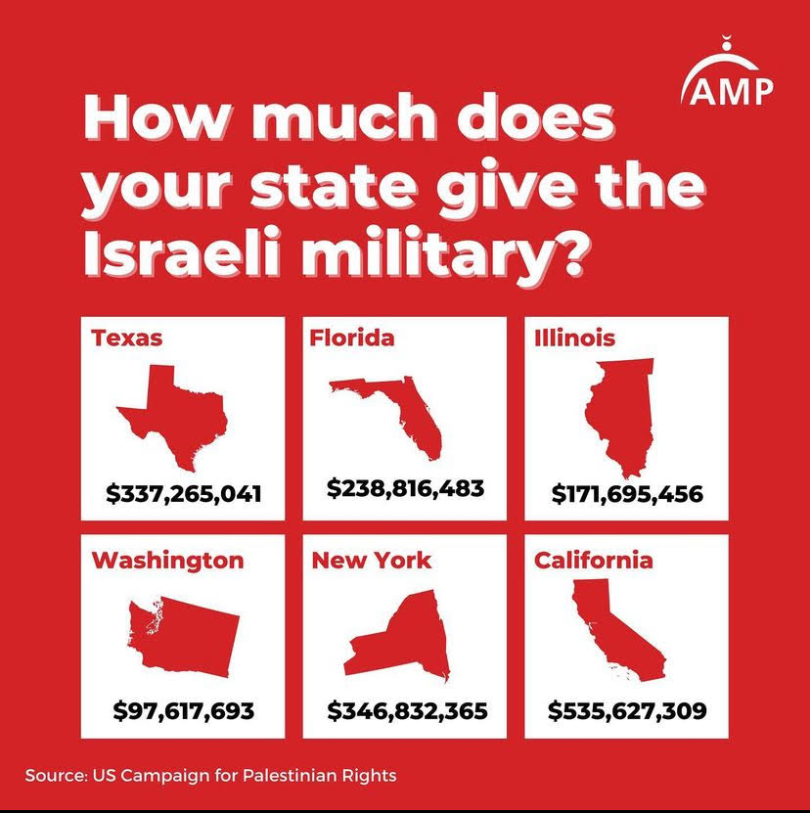
WHY ARE WE HERE?
ONGOING GENOCIDE IN GAZA
U.S. PROVIDES $3.8+ BILLION OF U.S. TAX DOLLARS TO ISRAEL
CALLS FOR SOLIDARITY FROM PALESTINIAN TRADE UNIONS

Slide 5
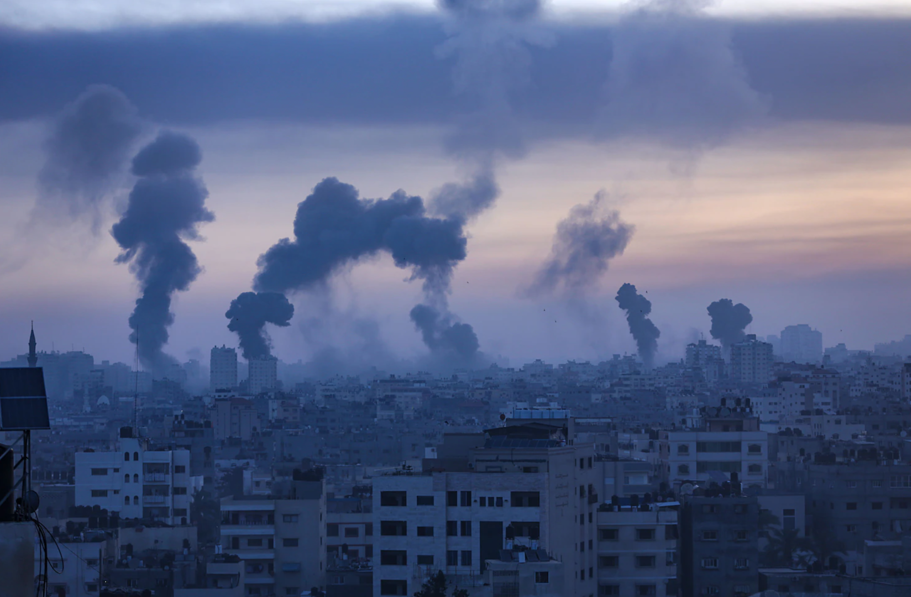
THIS DIDN’T START ON 7 OCT

Slide 6
Idealist Framework
Materialist Framework
A timeless religious conflict between Jews and Muslims
Authoritarian (Palestine) vs. democratic (Israel) regimes
Clash of civilizations (barbaric v civilized)
Change will come through dialogue and understanding
Zionism is a product of European imperialism which drove the colonization of Palestine through imperialist expansion
Change will come through struggle between colonized people against their colonizer
Not helpful or accurate. Obscures material reality.
Notes:
But I want to take a quick step back
people don’t work against their interests

Slide 7
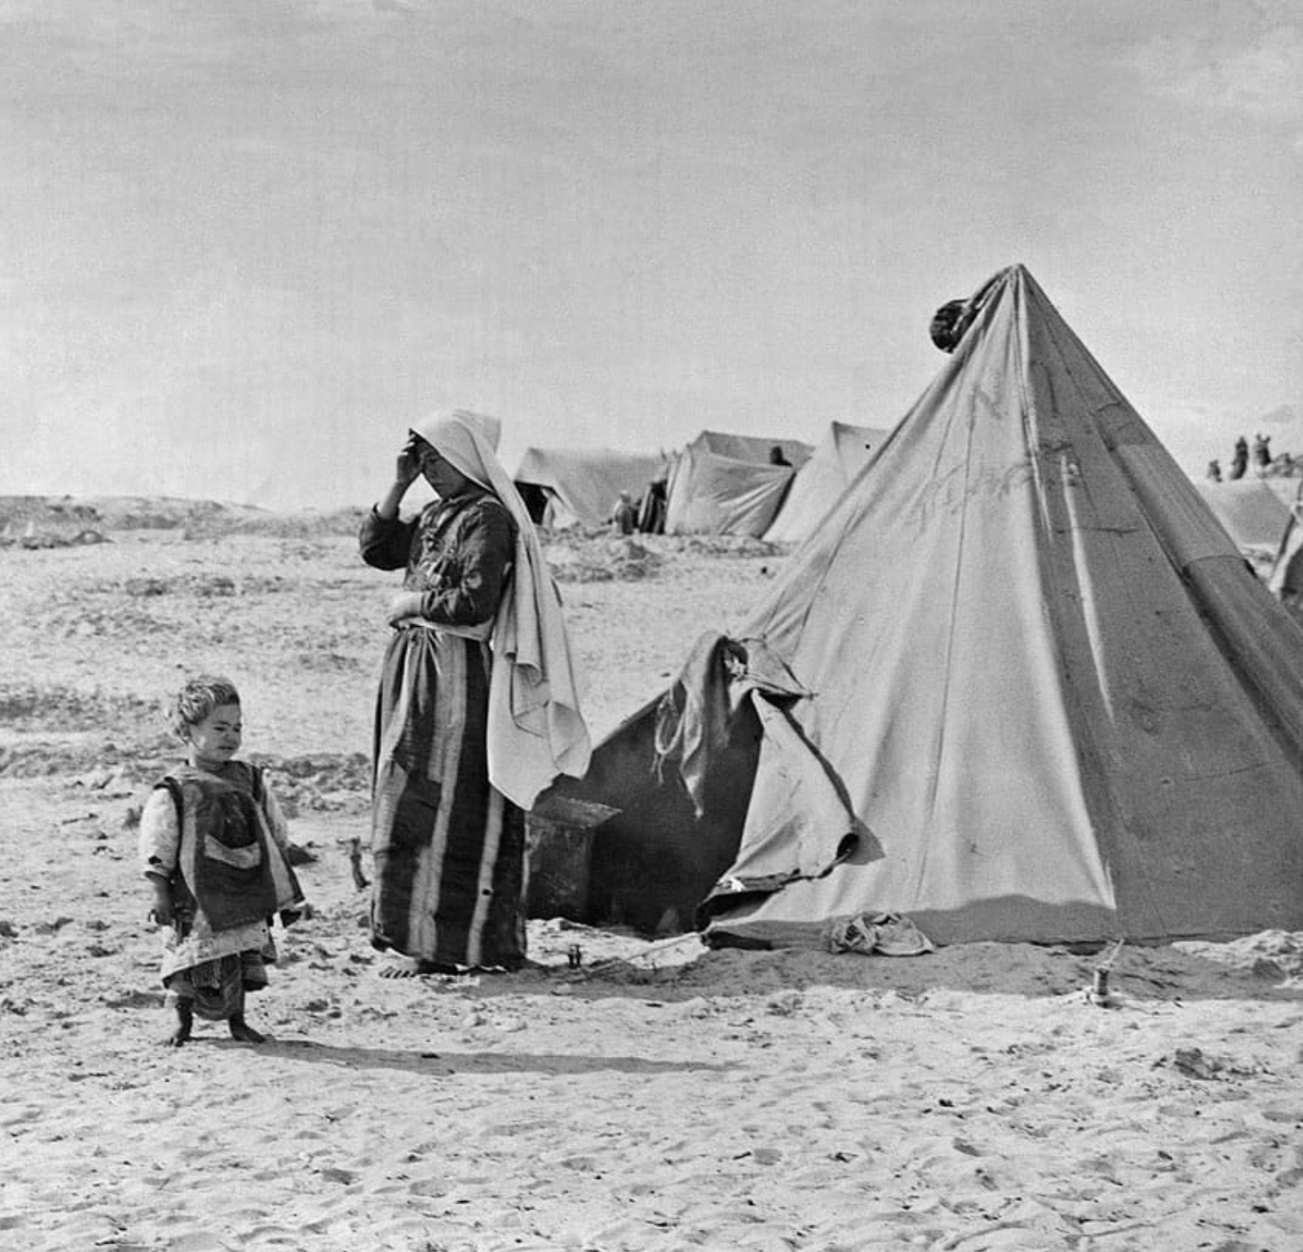
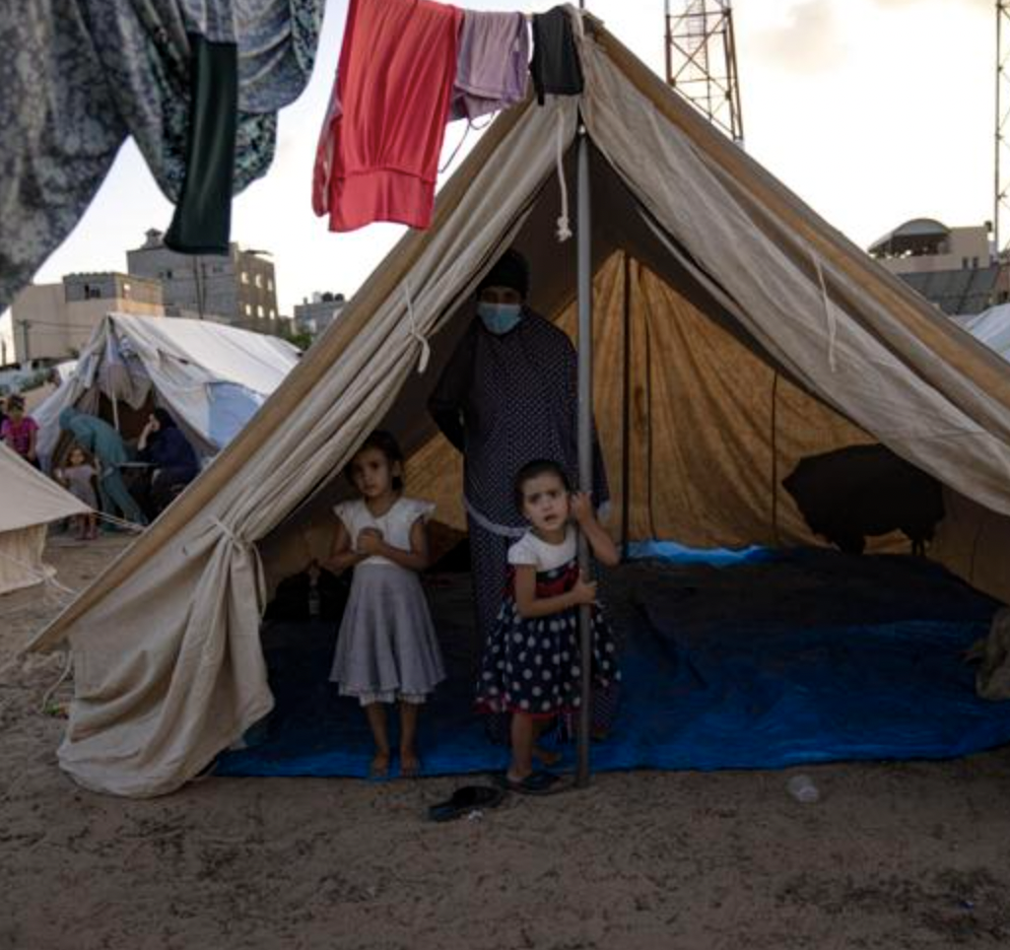
Understanding the Palestinian struggle through a materialist framework means we need to understand the conditions that led to this moment, and historicize and contextualize the decades of colonial violence prior to October 7th.
1948
2023
Notes:
Both images from Khan Younis

Slide 8
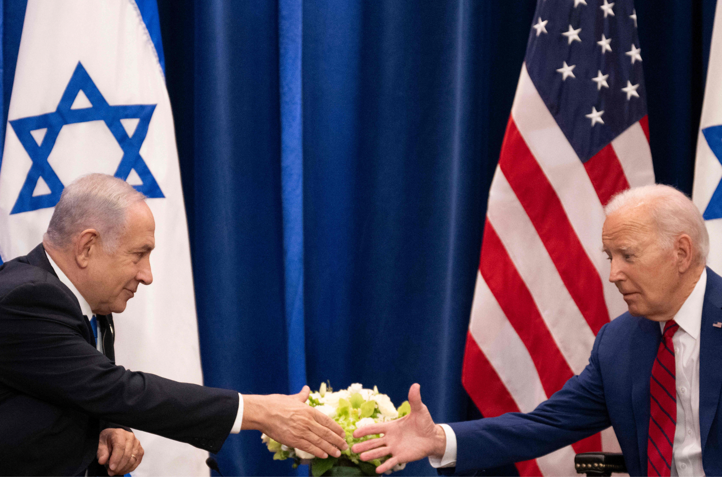
ZIONISM AND IMPERIALISM
Notes:
how many ppl here are familiar with the term zionism?
how many are familiar with the term imperialism?

Slide 9
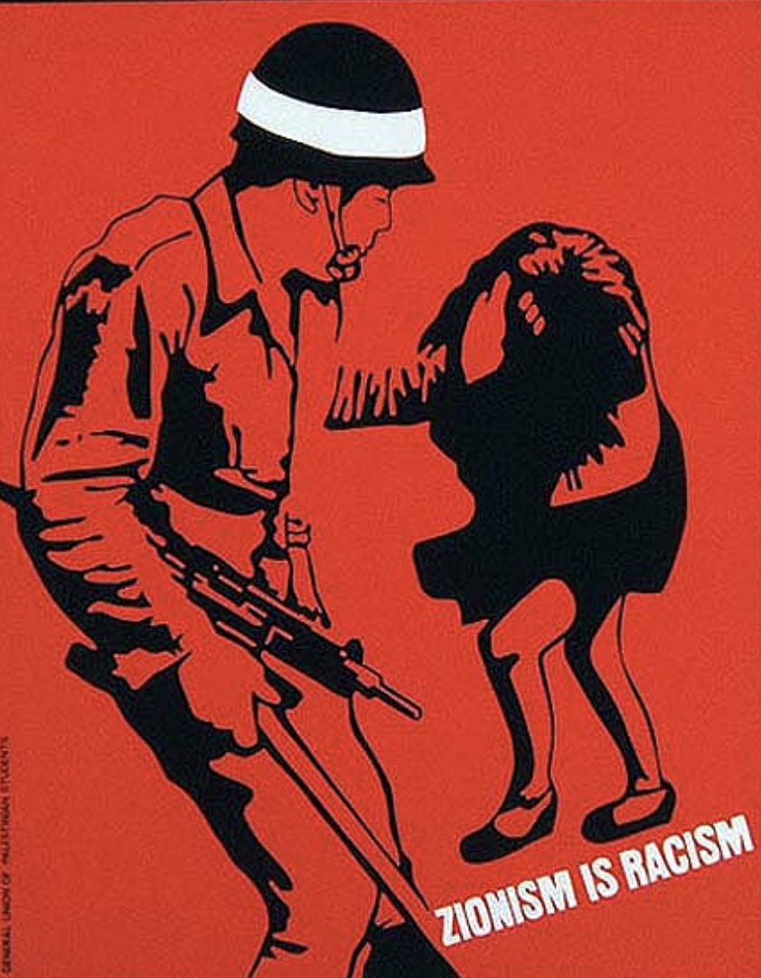
ZIONISM is a settler-colonial and fascist ideology that was born in the late 1800s in Europe. It was a movement led by the bourgeoisie (capitalists) who partnered with European powers to gain their support. It believes in establishing a Jewish ethnostate in Palestine.

Slide 10
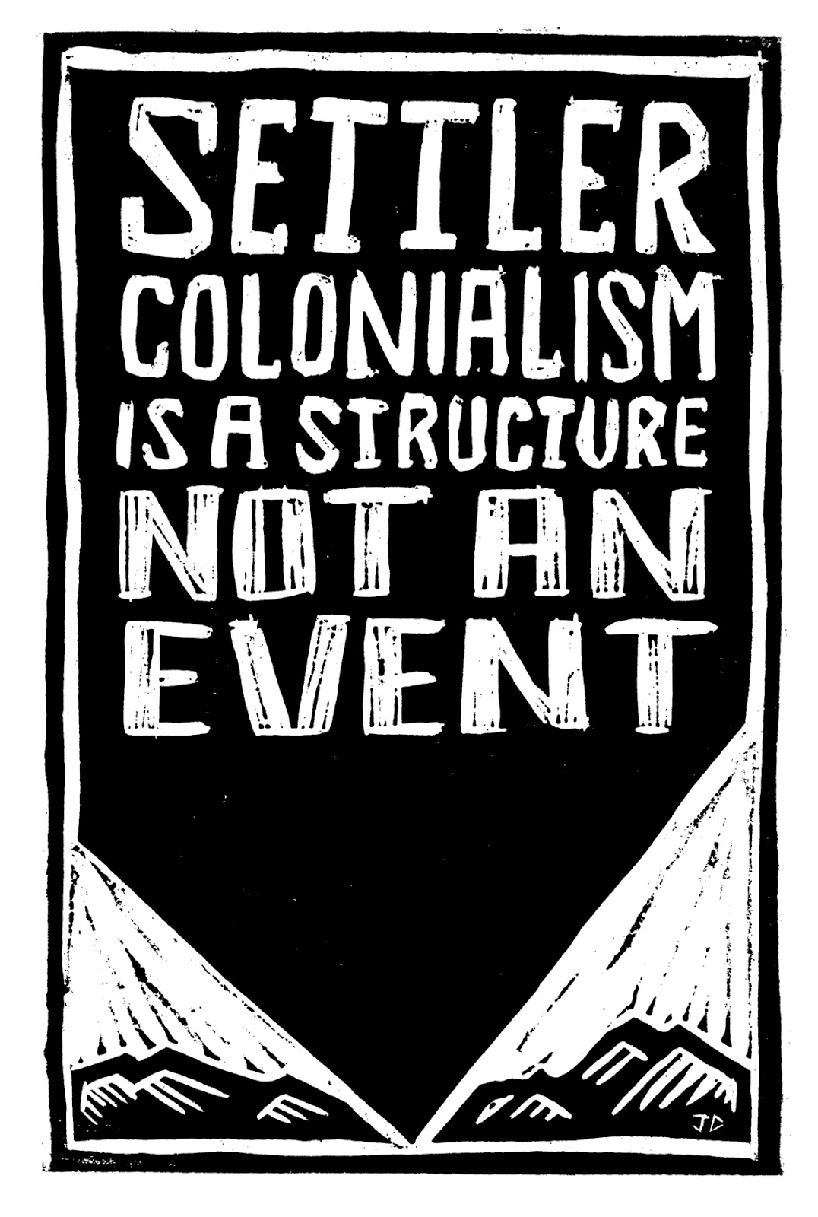
WHAT IS
SETTLER COLONIALISM?
Settler colonialism is the process by which a foreign people invade a territory under the oversight of an imperial power and settle on the land (land without the people).
It requires the displacement of the indigenous population.
Notes:
settler colonialism is process-- it is not a moment-- a process by which a people enter a land that is not theirs and settle it
imperial power who can give military and diplomatic support
land w/o the people
The goal of zionism is to build a Jewish ethnostate in Palestine. if there is already a people living there, how is this done in practise? settler colonialism, ethnic cleansing

Slide 11
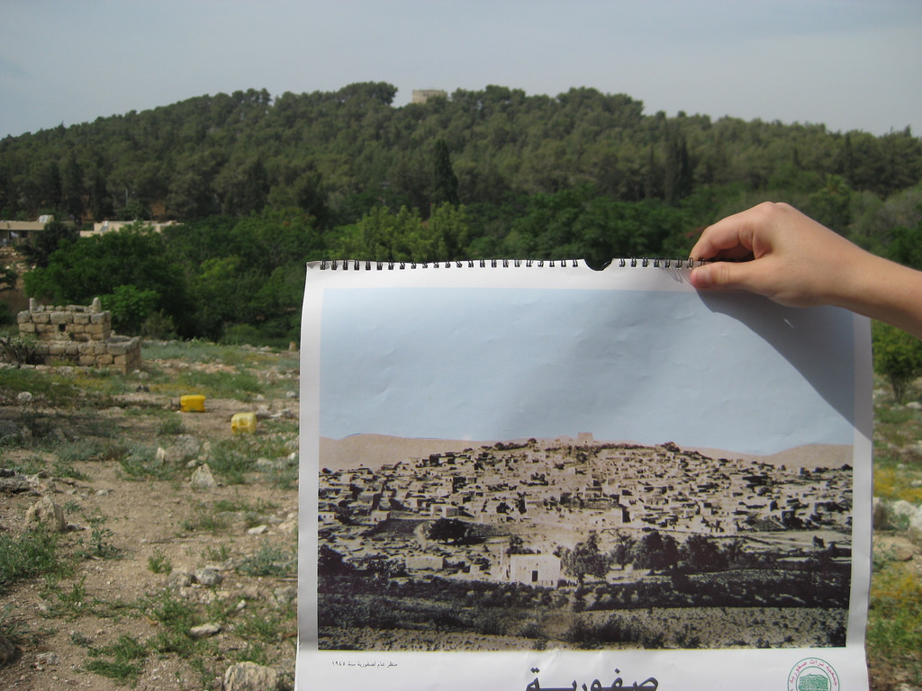
SETTLER COLONIALISM DESTROYS TO REPLACE

Slide 12
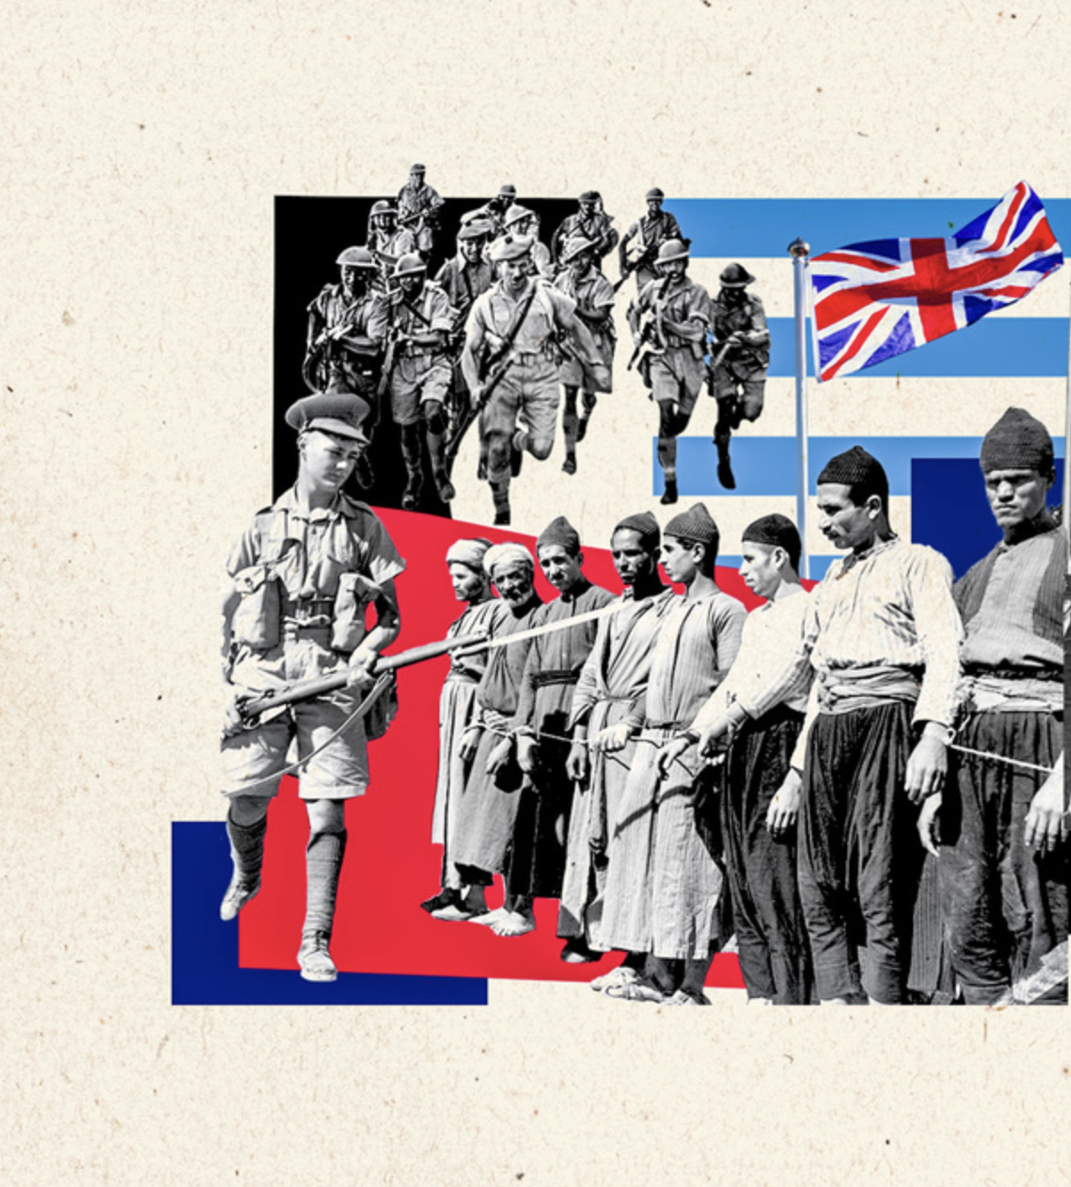
BRITAIN viewed Zionism as a way to secure their empire’s control of the region.
Notes:
In the early days, zionism found a political supporter in Britain, who viewed Zionism as a way to secure the British Empire’s control over the region and in so doing, secure their material interests.

Slide 13
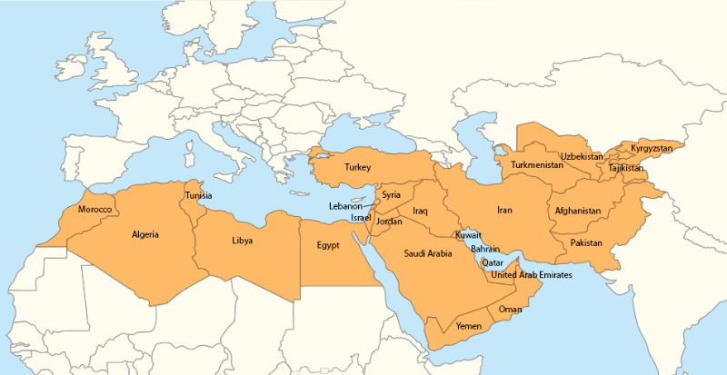
WHERE ARE WE?
Notes:
palestine -> settler-colonialism erases to replace
important to British interests in the region eg
Suez Canal (still today a billion dollar industry, $9.4B last year)
overland route to India
important trade routes, eg Iran where the British empire had oil concessions (Anglo-Iranian oil => BP)
just a few examples to describe how important controlling Palestine in order to ensure the stream of funds to the british empire

Slide 14
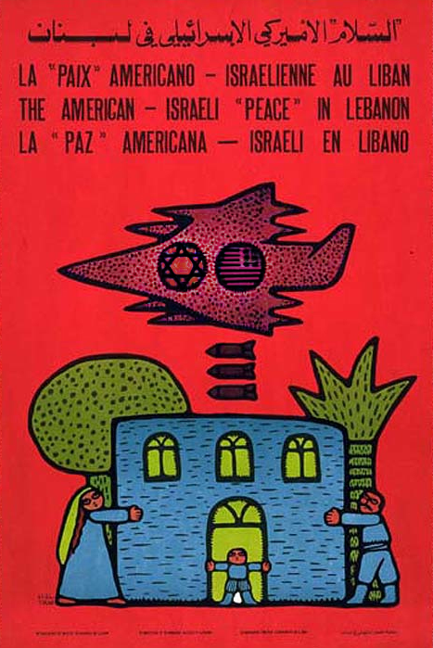
THE U.S. IS AN EMPIRE.
It dominates the people and land of the Global South to extract labor and resources (water, oil, metals, minerals) to fuel profits (money > people). It relies on proxies to secure this domination.
One of its proxies is Israel.
Notes:
Like Britain,

Slide 15
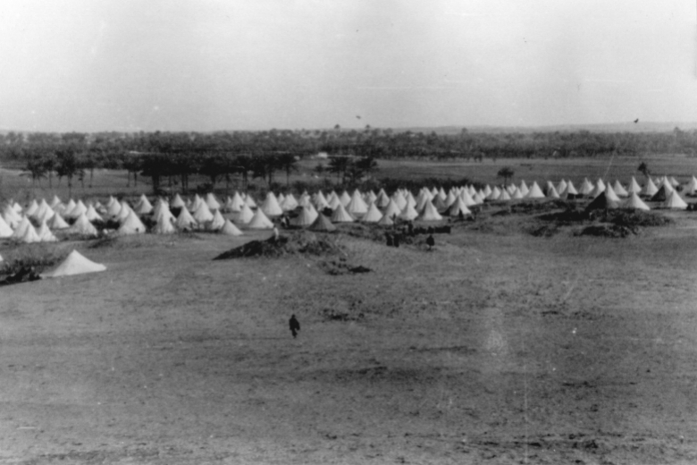
HISTORICAL CONTEXT
(1948-2005)
Notes:
this didn’t start 7 oct, Palestinians have been living under zionist settler-colonialism for over 75 yrs

Slide 16
“The right to exercise national self-determination in the State of Israel is unique to the Jewish people.”
Israel’s Basic Law (2018)

Slide 17
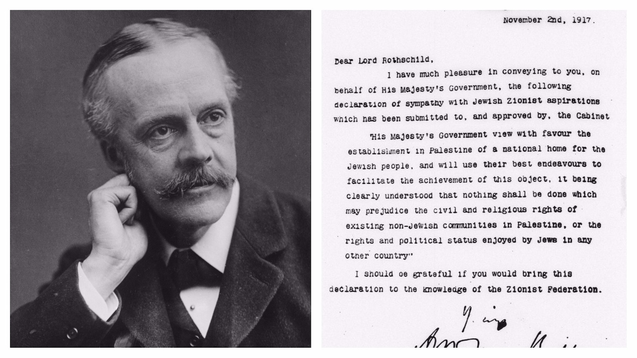
BALFOUR DECLARATION, 1917
His Majesty's Government view with favour the establishment in Palestine of a national home for the Jewish people… it being clearly understood that nothing shall be done which may prejudice the civil and religious rights of existing non-Jewish communities in Palestine...
Notes:
british gave their support to zionism, both financially, militarily, and diplomatically
british saw a way to do that through zionism
through a mix of that and christian zionism, Arthur Balfour (foreign secretary) made his infamous declaration in 1917 pledging the british empire’s support of the zionist project in palestine
key points
Vague promise of land for Jews (no mention of state)
Colonial erasure: “non-Jew”
Negating political embodiment: Civil and religious rights, not political rights
this legitimises the zionist project and gives it greater political force
----
At the same time Zionism as a movement for Jewish self-determination / nationalism was growing in Europe due to intensifying anti-semitism there → powerful lobbying power, pressuring the British to help solve the problem.
→ Balfour declaration NOVEMBER 2, 1917 (next few days)
United Kingdom's Foreign Secretary Arthur Balfour to Lord Rothschild, a leader of the British Jewish community,
Text of Balfour Declaration
His Majesty's Government view with favour the establishment in Palestine of a national home for the Jewish people, and will use their best endeavors to facilitate the achievement of this object, it being clearly understood that nothing shall be done which may prejudice the civil and religious rights of existing non-Jewish communities in Palestine or the rights and political status enjoyed by Jews in any other country.
Vague promise of land for Jews (no mention of state)
Demonstrates vying claims to the land known as historic palestine
Colonial erasure: “non-Jew”
Negating political embodiment: Civil and religious rights, not political rights

Slide 18
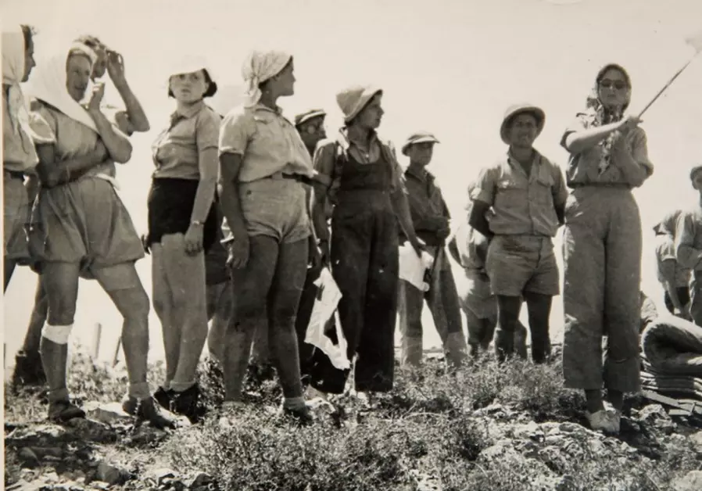
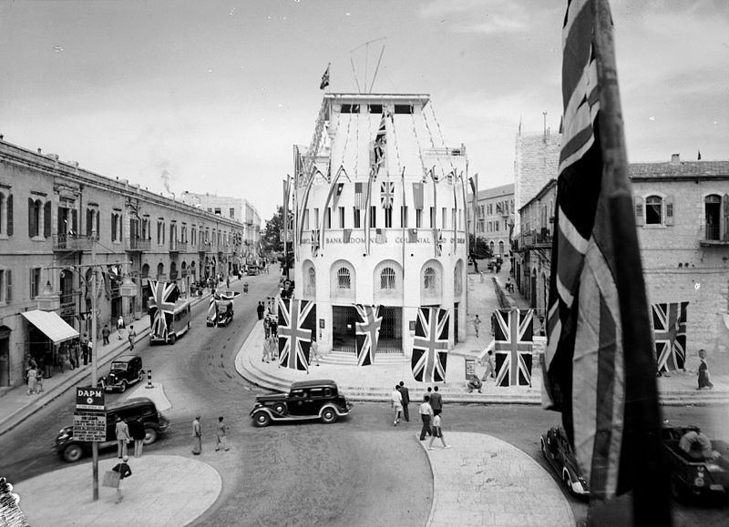
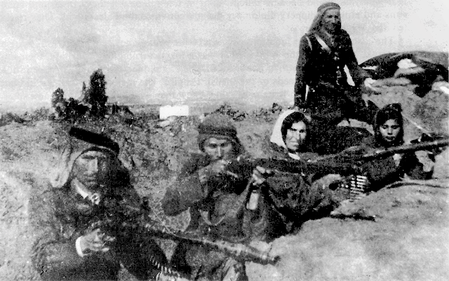
BRITISH MANDATE, 1917-1948
Jewish migration and pre-state structures
British administrative and military control
Arab Revolt 1936-1939
Notes:
British took colonial control over Palestine in 1917 under the british mandate
what is important about the British Mandate period is that the British allowed for zionists to build their own infrastructure, which became pre-state structures, and passed laws to try to move land out of Palestinian hands and into Zionist hands.
schools, hospitals, and importantly militias
British army trained and equipped zionist militias, eg Orde Wingate trained Haganah
Palestinians resisted at every turn, especially the peasantry who were most affected by the new laws and resultant landlessness
led to 1936 strike and revolt

Slide 19
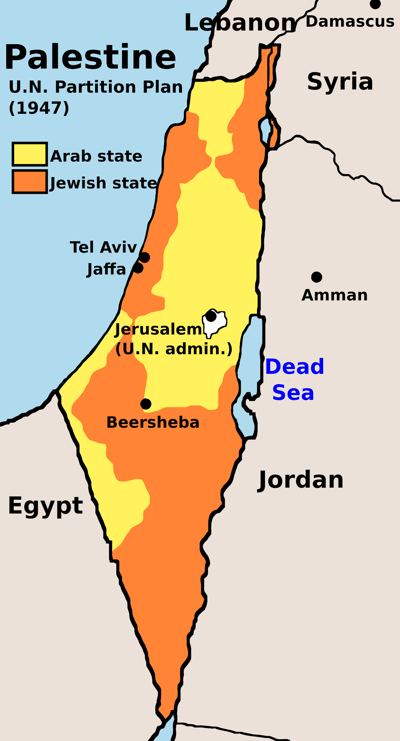
PARTITION PLAN, 1947
Resolution 181, passed on November 29, 1947, called for the partition of Palestine into Jewish and Arab states.
Despite the fact that Zionist settlers made up only one third of the population in Mandatory Palestine by 1947 and only owned 7% of private land, the U.N. plan allocated ~55% of the territory to the proposed Jewish state and just 42% to the proposed Arab state.
The Arab Higher Committee (the main political leadership of the Palestinian national movement between 1937-1948) rejected the U.N. plan on the grounds that the Palestinian people should not be forced to give up more than half of their country and forfeit their own nationalist aspirations.
Notes:
Run thru - 10 seconds
Palestinians never agreed to give away our land

Slide 20
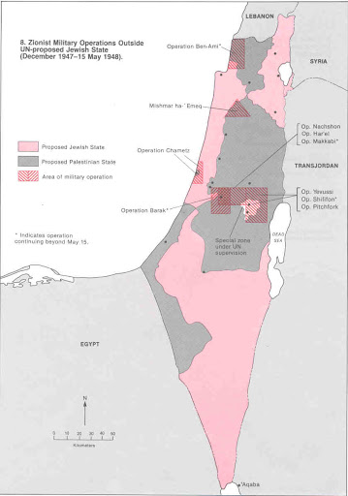
PLAN DALET, 1948
Blueprint for the ethnic cleansing of Palestine:
Specified which Palestinian population centers should be targeted and laid out in detail a plan for their forcible depopulation and destruction
Plan D called for:
"Mounting operations against enemy population centers located inside or near our defensive system in order to prevent them from being used as bases by an active armed force. Categories:
"Destruction of villages (setting fire to, blowing up, and planting mines in the debris), especially those population centers which are difficult to control continuously.
"Mounting search and control operations according to the following guidelines: encirclement of the village and conducting a search inside it. In the event of resistance, the armed force must be destroyed and the population must be expelled outside the borders of the state."
Notes:
Run thru - 10 seconds

Slide 21
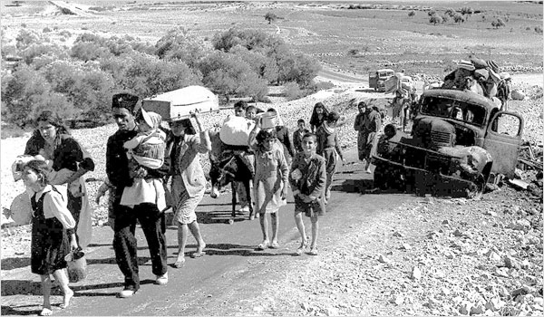
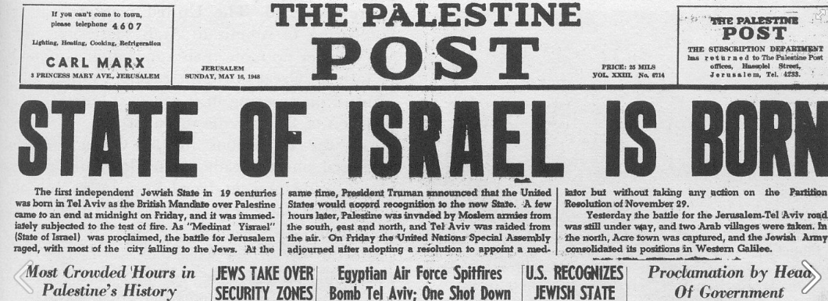
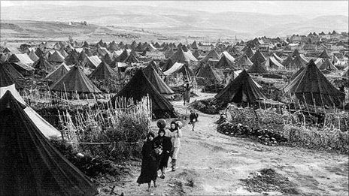
NAKBA, 1948
Notes:
Nakba - the Catastrophe
people forced to flee on foot with whatever they could carry
many people thought they would be able to return, but were physically prevented from doing so
refugeehood => today, most Palestinians live outside of Palestine
----
quick stories:
Jaffa
Lydd, Ramleh
Deir Yassin

Slide 22
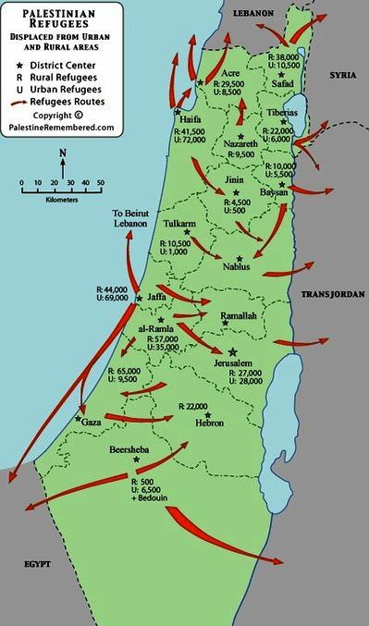
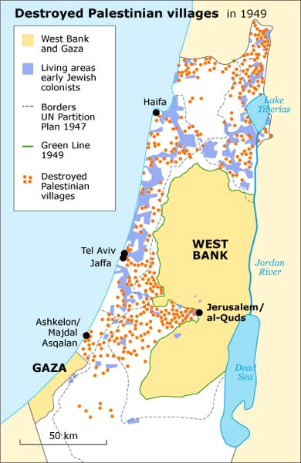
The Nakba (Catastrophe)
Between 1947-1950 more than 500 Palestinian towns/villages were destroyed
An estimated 800,000 Palestinians were ethnically cleansed from the land.
While many were internally displaced within Palestine, most fled to Jordan, Syria and Lebanon.
Notes:
Run thru - 15 seconds
by the end of the Nakba, over 750K+ Palestinians had been displaced
zionists controlled 78% of the land (more than what had been allotted in the partition plan)
zionists then set about consolidating their gains

Slide 23
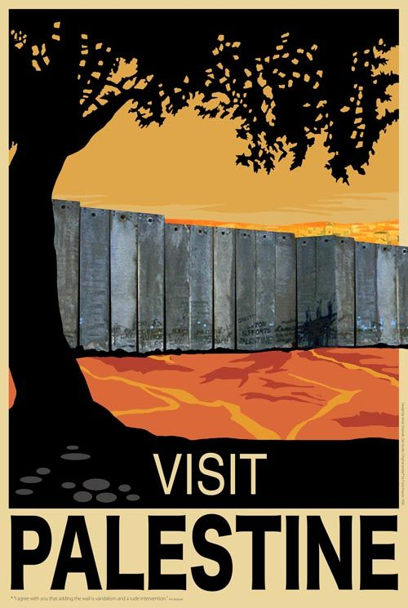
Deep Dive: Zionism & Antisemitism
Notes:
we’ve talked about what zionism has meant for Palestinians. i’ll pass it over to do a deep dive in to Zionism and anti-semitism.

Slide 24
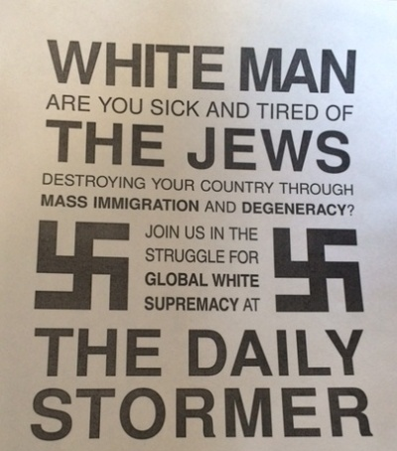
ANTISEMITISM
“Originating in European Christianity, antisemitism is the form of ideological oppression that targets Jews. In Europe and the United States, it has functioned to protect the prevailing economic system and the almost exclusively Christian ruling class by diverting blame for hardship onto Jews…The myth changes and adapts to different times and places, but fundamentally it says that Jews are to blame for society’s problems.”
Jews for Economic and Racial Justice
Notes:
We can’t talk about zionism without first understanding antisemitism, and how it has historically functioned, particularly within European Christianity.
Understanding antisemitism deserves an entire lecture because it is so poor understood but there are countless examples from the Spanish Inquisition to the ghettoization of Jewish communities in Italy to the Holocaust that highlight this dynamic.
I think one key example was how Jews were by and large excluded from economic systems except for as money lenders and tax collectors, since this was deemed “unchristian.”

Slide 25
ANTISEMITISM & OTHER FORMS OF OPPRESSION
Differences
Antisemitism does not necessarily view Jews as ‘inferior’; instead, it paints Jews as capable but malicious and untrustworthy
Within white supremacist thinking, Jews are perceived as participating in a conspiratorial plot to undermine White Christian America by organizing women, POC, immigrants, etc.
“Jews will not replace us!”
Pizza gate, Globalists, etc.
Similarities
Antisemitism is cyclical in nature. It has waxed and waned in history depending on the social and economic climate
Antisemitism has been used to protect the ruling class during economic downturns by using Jews as a scapegoat
Antisemitism interacts and overlaps with other forms of oppression
Notes:
Akin to the model minority myth

Slide 26
ANTISEMITISM & SETTLER COLONIALISM
Settler colonialism fits into the framework of antisemitism, in which Jews serve as a buffer between the ruling class (England) and oppressed people (Palestinians)
Balfour was a known antisemite
Balfour Declaration allowed England to solve its “Jewish problem” by relocating Jewish refugees rather than addressing antisemitism
In establishing a Jewish state in Palestine, Britain saw an opportunity to maintain its control and influence over the region
Herbert Samuel’s 1915 memorandum The Future of Palestine laid out a series of reasons why it would be beneficial to establish a Jewish state in Palestine, one of which was to “enable England to fulfill in yet another sphere her historic part of civiliser of the backward countries.”
Notes:
This is setting up the next section focused on settler colonialism, but it’s important to highlight

Slide 27
ANTISEMITISM AS THE CATALYST FOR ZIONISM
In the late 19th century, there was a new wave of antisemitism across Europe + a rise in nationalism across Europe
Pogroms in Russia (1881-1884 and 1918-1920): Fiddler of the Roof
Dreyfus Affair (1894): French Jewish captain falsely accused of treason
Herzl proposed Zionism as a response to European assimilation
False belief that an established Jewish state would provide “self-determination” and protection from escalating persecution in Europe
Zionism gained some political support post-WWI with the 1917 Balfour Declaration, but it was not until after the Holocaust that it gained broader global support
Notes:
Context: The age of enlightenment had just ended, which was supposed to be a time of religious tolerance and the separation between church and state, yet antisemtism was still rampant in Europe
Herzl covered the Dreyfus Affair as a journalist and realized that Jewish assimilation was a “failed project”
After the Balfour Declaration, Britain invested in Zionist militias in Israel between 1917 and 1948 such as the Haganah
The first prime minister of Israel, David Ben-Gurion, was a leader in Haganah and played a major role in the Nakba

Slide 28
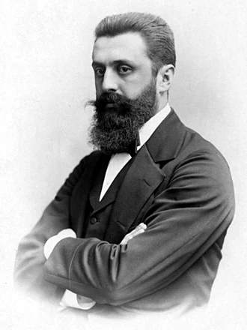
WHAT IS ZIONISM?
Definition: A nationalist movement that supports the establishment and maintenance of a Jewish ethnostate in historic Palestine
Founded by Theodor Herzl in 1896 with his seminal work, Der Judenstaat or “The State of the Jews”
Theordor Herzl aligned with messianic Christian leaders who believed that returning Jews to Israel aligned with biblical prophecy to bring about the second coming
The beginning threads of Christian Zionism
An inherently antisemitic belief system
Theodor Herzl
Notes:
Today, we can loosely think of Zionism/political Zionism as the ideology that justifies the existence of the state of Israel at the direct expense of the Palestinian people, as well as belief in the necessity for this state to be maintained in direct opposition to Palestinian sovereignty, freedom and independence.
Zionism in its updated form is best understood as a *political* ideology that uses religious justifications for its advocation of a modern nation-state as a solution to issues of oppression. (More on this in a minute)

Slide 29
HERZL QUOTES
“We should there form a portion of a rampart of Europe against Asia, an outpost of civilization as opposed to barbarism. We should as a neutral State remain in contact with all Europe, which would have to guarantee our existence.”
Theodor Herzl

Slide 30
HERZL QUOTES
“Both the process of expropriation and the removal of the poor must be carried out discreetly and circumspectly. Let the owners of the immoveable property believe that they are cheating us, selling us things for more than they are worth. But we are not going to sell them anything back.”
Theodor Herzl

Slide 31
KEY ZIONIST QUOTES
“It must be clear that there is no room for both people in this country. No ‘development’ will bring us closer to our aim, to be an independent people in this small country. If the Arabs leave the country, it will be broad and wide-open for us. And if the Arabs stay, the country will remain narrow and miserable...The only solution is Eretz Israel (a Jewish state) without Arabs.”
Josef Weitz, Director of the Land and Afforestation Department - Jewish National Fund , 1940
Notes:
JNF has played a key role in turning ethnically cleansed and destroyed Palestinian Villages into green spaces. strategically planting trees over Palestinian and Bedouin villages. It also plays into the idea that Palestine was a desert and Jews “made it bloom”
Greenwashing: the use of environmentalism and ecological preservation to distract from occupation/apartheid
https://www.haaretz.com/israel-news/2022-07-20/ty-article/.premium/an-israeli-hunk-cannot-conceal-the-jewish-national-funds-greenwashing/
https://www.timesofisrael.com/why-tree-planting-in-the-negev-sparked-protests-riots-and-a-coalition-crisis/

Slide 32
KEY ZIONIST QUOTES
”There is no way besides transferring the Arabs from here to the neighboring countries, and to transfer all of them, save perhaps for [the Arabs of] Bethlehem, Nazareth and Old Jerusalem. Not one village must be left, not one [bedouin] tribe. And only after this transfer will the country be able to absorb millions of our brothers and the Jewish problem will cease to exist. There is no other solution.”
Josef Weitz, Director of the Land and Afforestation Department - Jewish National Fund , 1940

Slide 33
KEY ZIONIST QUOTES
“We must expel the Arabs and take their places and if we have to use force to guarantee our own right to settle in those places then we have force at our disposal.”
“During the assault, we must be ready to strike the decisive blow; that is, either to destroy the towns or expel its inhabitants so our people can replace them.”
David Ben Gurion, First Prime Minister of Israel
Notes:
Leader of Zionist milita

Slide 34
KEY ZIONIST QUOTES
“Now a transfer of a completely different scope will have to be carried out. In many parts of the country new settlement will not be possible without transferring the Arabs."
"I support compulsory transfer. I don't see anything immoral in it.”
David Ben Gurion, First Prime Minister of Israel

Slide 35
ZIONISM TODAY
The primary goal of Zionism is the establishment and maintenance a Jewish majority, ethnostate in Israel
Bringing more Jews to Israel via aliyah and Birthright
The removal of Palestinian people through violence, forced removal and imprisonment
Relies on global antisemitism to continue escalating and rising, to further validate and legitimize the “need” for a Jewish safe haven
There has been a massive movement to redefine Zionism as the Jewish “right to self-determination”
Equates Zionism with Judaism and Jewish identity so that criticism of Zionism can then be defined as antisemitism
Notes:
We could probably have a whole separate lecture about Birthright, but there are a few things worth mentioning:
The name Birthright insinuates that Jews who previously had no connection to Israel have a right to travel and settle there because they are Jewish
It’s a free trip subsidized by the Israeli government with the explicit purpose of creating a connection between the Jewish diaspora and Israel
It’s primary focus is 18-26 (although this has been expanded to 35 more recently) which is strategic for two reasons: IDF conscription and reproductive viability
It is a recruitment tactic to bring more young Jews to Israel in hopes that they will also have Jewish babies (eugenic project)
The requirement that applicants have not spent time in Israel, so they can provide a very specific experience and they know the longer people spend in Israel, the harder it is to ignore the occupation and apartheid

Slide 36
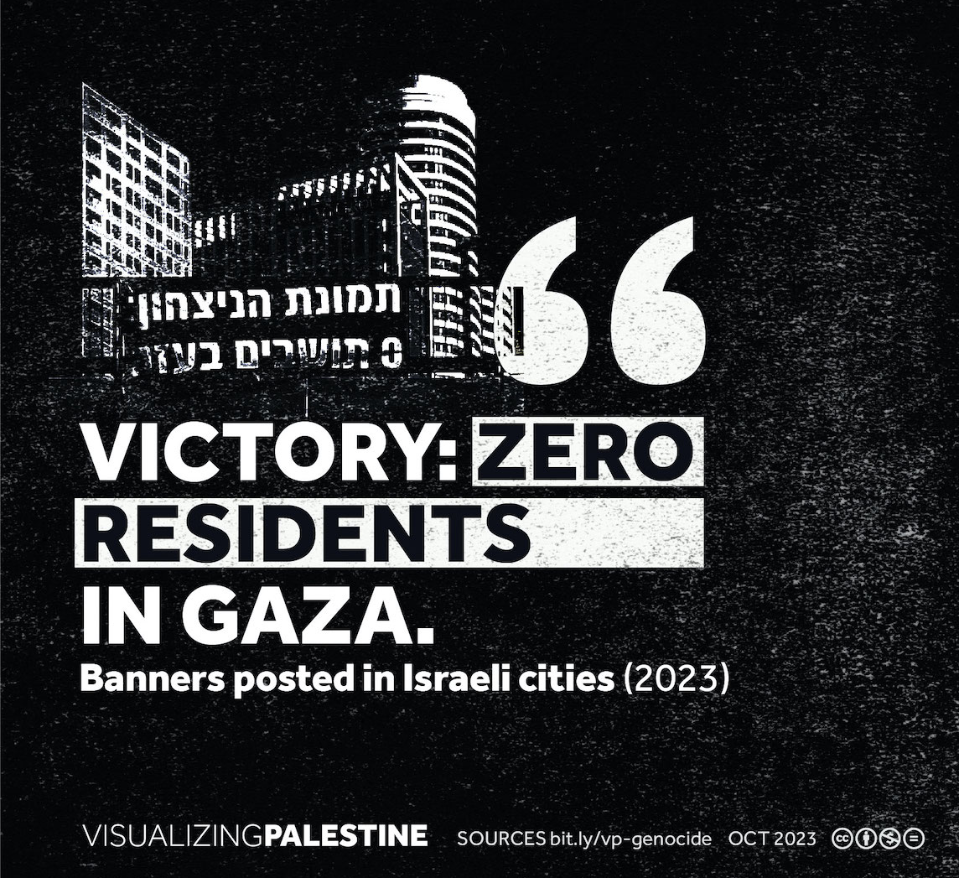
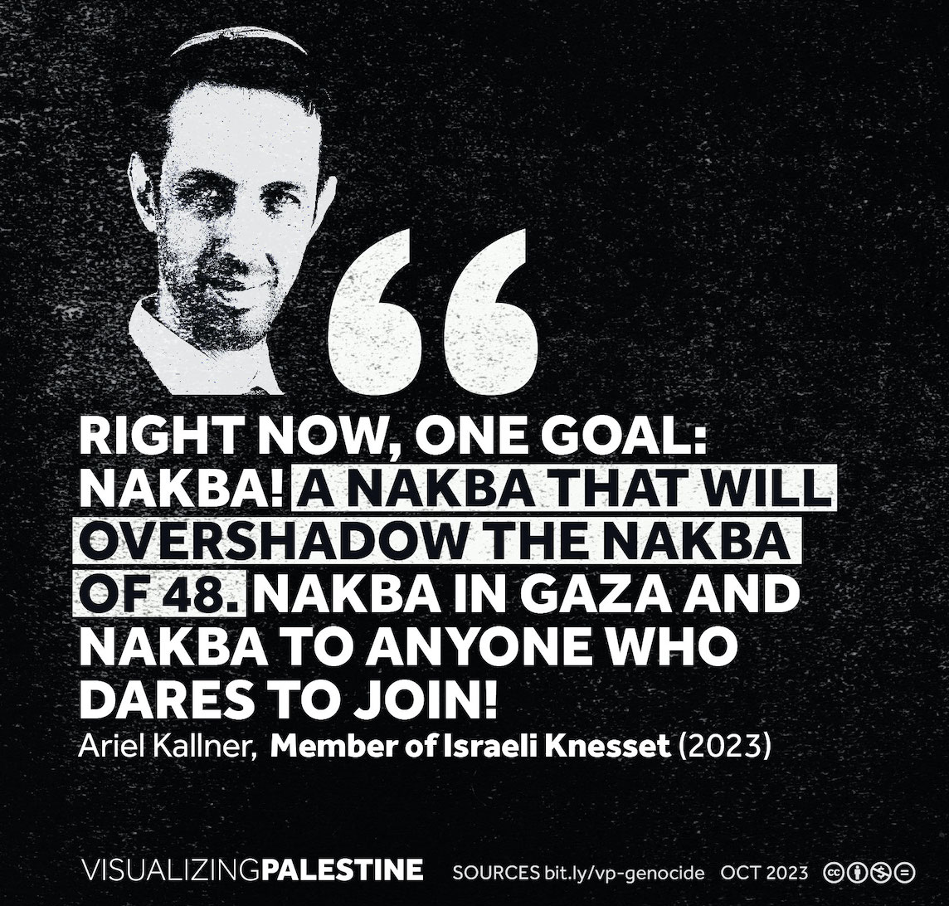
Notes:
ADD QUOTES. Some people argue that Zionism was a colonial project in the past, but now is more of a “cultural belief in the right for Israel to exist.” Here are some very recent quotes that suggest otherwise.

Slide 37
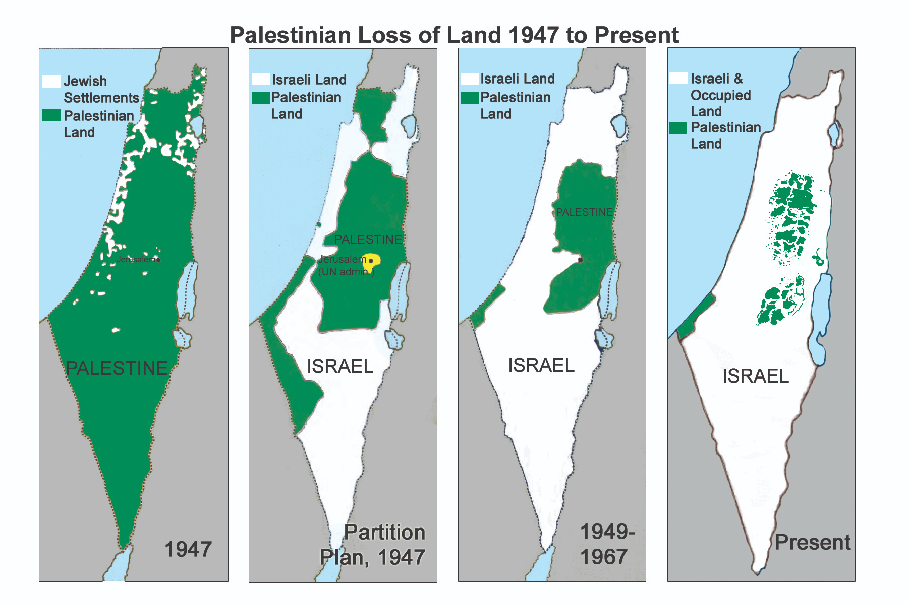
ZIONIST LOGIC:
THE BASIS OF ISRAEL
Jewish majority state
=
Maximum Jews on Maximum Land
→ Settler- Colonialism

Slide 38
ANTI-ZIONISM =/= ANTI-SEMITISM
Antisemitism was and remains a problem.
Zionism was a colonial “solution” to antisemitism in Europe, at the direct expense of both Jews and Palestinians.
Anti-zionism is inherently aligned with Jewish values such as liberation, justice and solidarity with other oppressed groups.
Criticism of Israel is not antisemitic just like criticism of the United States is not un-American
Many supporters of Zionism and/or Israel are actually antisemitic (e.g., Balfour, Christian Zionists)
Notes:
This is a key takeaway that all Palestine 101 presentations should convey.

Slide 39
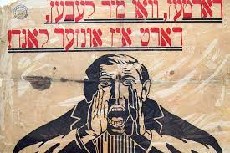
HISTORY OF ANTI-ZIONISM
Anti-Zionism has existed as long as Zionism has existed
Socialist or Communist Jews rejected Zionism for being in opposition to class solidarity
Anarchist Jews opposed the concept of nation-states, Jewish or otherwise
Reform Judaism was historically at odds with Zionism, and favored the idea of Americanization or assimilation
Ultra-Orthodox Jews oppose Zionism based on religious beliefs
Notes:
In 1845, Samuel Hirsch, David Einhorn and Samuel Holdheim passed a resolution at the Frankfurt Conference that removed references to Palestine and a "Jewish State" from prayers on the grounds that nationalism and statehood were not compatible with Reform theology
The Columbus Platform of 1937 which affirmed the "obligation of all Jewry" to build a "Jewish homeland" in Palestine and to make it "not only a haven of refuge for the oppressed but also a center of Jewish culture and spiritual life"
The Miami Platform in 1997 was dedicated to the issue of Zionism. The text of the platform asserts the American Reform movement's support for Israel and the Zionist movement, saying that "Medinat Yisrael serves uniquely as the spiritual and cultural focal point of world Jewry" and that the destinies of "Israeli and Diaspora Jewry" are dependent and responsible for one another.
https://en.wikipedia.org/wiki/Reform_Zionism

Slide 40
ANTI-ZIONISM TODAY
Anti-Zionism is the criticism of Zionism, Israeli state policies, and/or moral, ethical, or religious criticism of the idea of a Jewish nation-state
Anti-Zionism rejects the necessity of a Jewish, ethnostate and recognizes Israel as a settler colonial project that upholds apartheid and military occupation
Anti-zionism believes that a vibrant, diasporic Jewish movement that operates from a place of solidarity is the antidote to antisemitism
White supremacy & Christian hegemony are the roots of antisemitism, which aligns Jewish, Palestinian, Arab and Muslim interests

Slide 41
ANTI-SEMITISM & WHITE SUPREMACY
“The successes of the civil rights movement created a terrible problem for White supremacist ideology... How could a race of inferiors have unseated this power structure through organizing alone? For that matter, how could feminists and LGBTQ people have upended traditional gender relations, leftists mounted a challenge to global capitalism, Muslims won billions of converts to Islam? ...Some secret cabal, some mythological power, must be manipulating the social order behind the scenes… Jews function for today’s White nationalists as they often have for antisemites through the centuries: as the demons stirring an otherwise changing and heterogeneous pot of lesser evils.”
-ERIC WARD
Notes:
This is important to understand within the context of U.S. politics and the ways in which Jews are used as a scapegoat for political unrest as well as social advancements
This has been very successfully wielded by Donald Trump and other right-wing Republicans

Slide 42
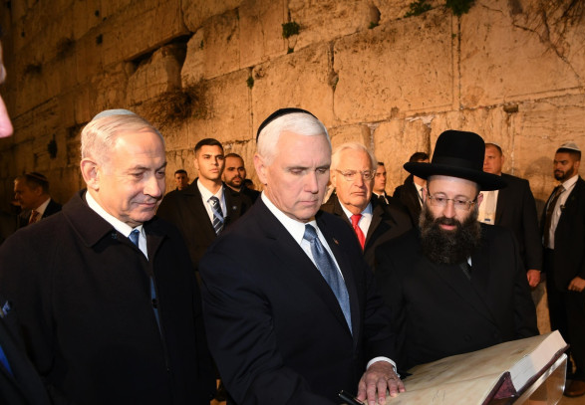
CHRISTIAN ZIONISM
Rooted in theological interpretations, some evangelical Christian denominations believe that in order to facilitate the second coming of Christ, Jews must “gather” in Israel as part of Biblical prophecy
‘If all the Jews go to Israel, this will fulfill the conditions of the Second Coming and allow for the ultimate triumph of Christianity!’
Christians United for Israel is one of the largest pro-Israel lobbies
Also provides financial support for illegal settlements in the West Bank
Notes:
Finally, it is important to acknowledge that support if Israel does not absolve someone of being antisemitic

Slide 43
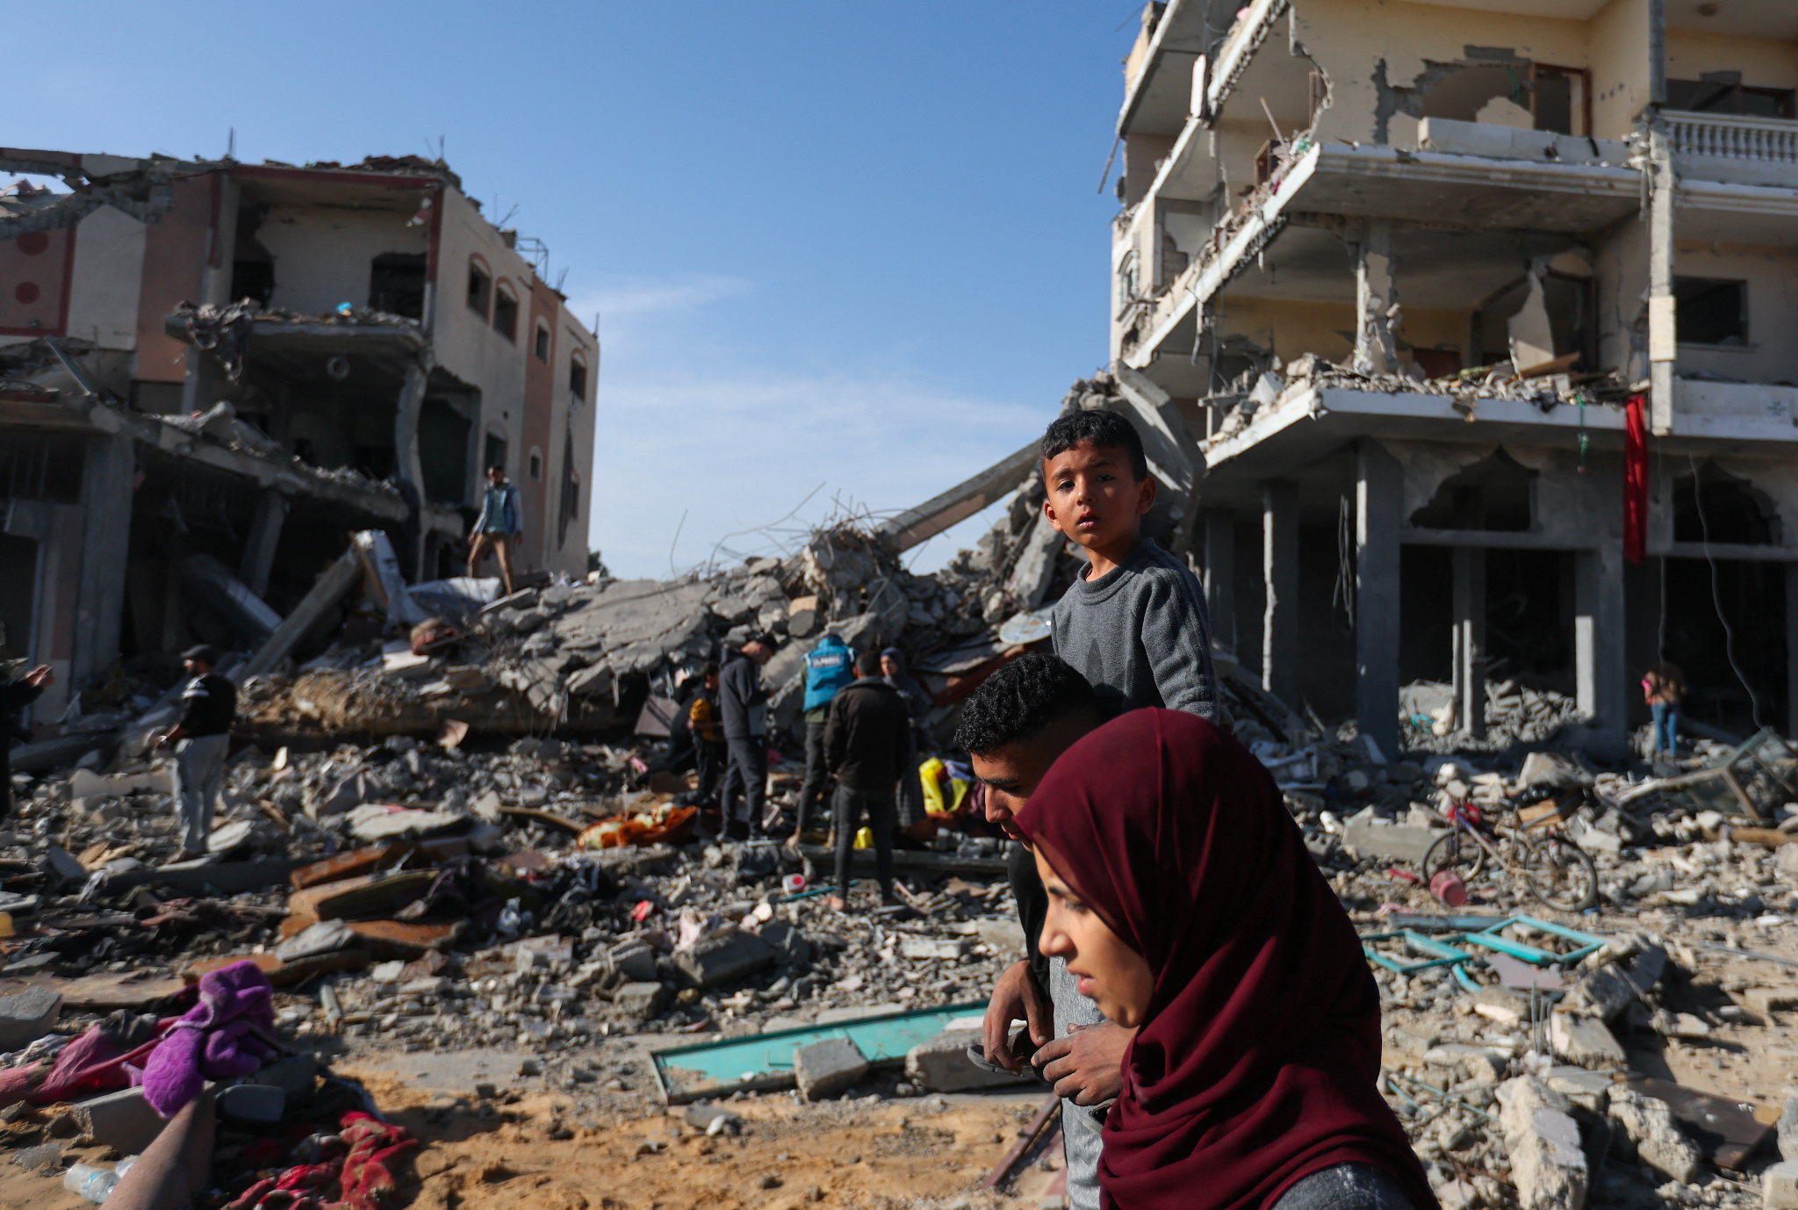
GAZA:
1990-2024

Slide 44
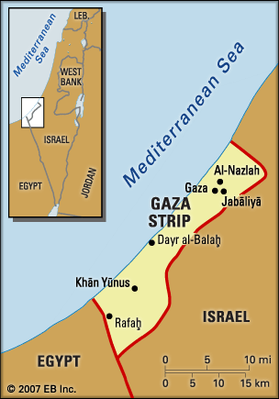
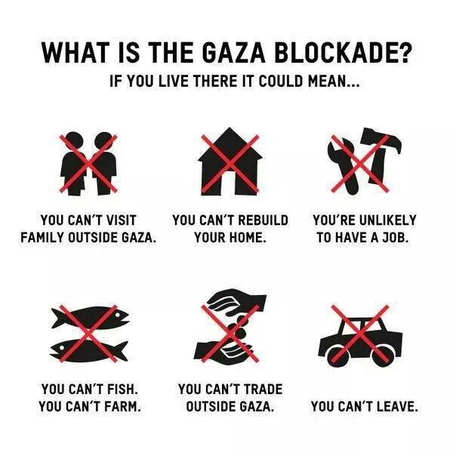
GAZA
80% of Palestinians in Gaza are refugees from 1948
2.3 million people squeezed into 141 sq ft
Israel has fenced in Gaza by land, air, and water
“Open air prison”
Notes:
people who have already been displaced by zionist genocide
Bombing schools, ambulances, universities, and sites of worship
Regularly target ports to prevent access to trade, airports to prevent movement, power plants resulting in electricity cuts – most recently the zionist entity bombed the Rafah border crossing, preventing vital aid from entering form Egypt

Slide 45
GAZA:
TOTAL
BLOCKADE
Notes:
over 2 million ppl are squeezed into 141 sq ft
Entry and exit by air and sea to Gaza has been prohibited since the 1990s, with Israel operating only two crossing points

Slide 46
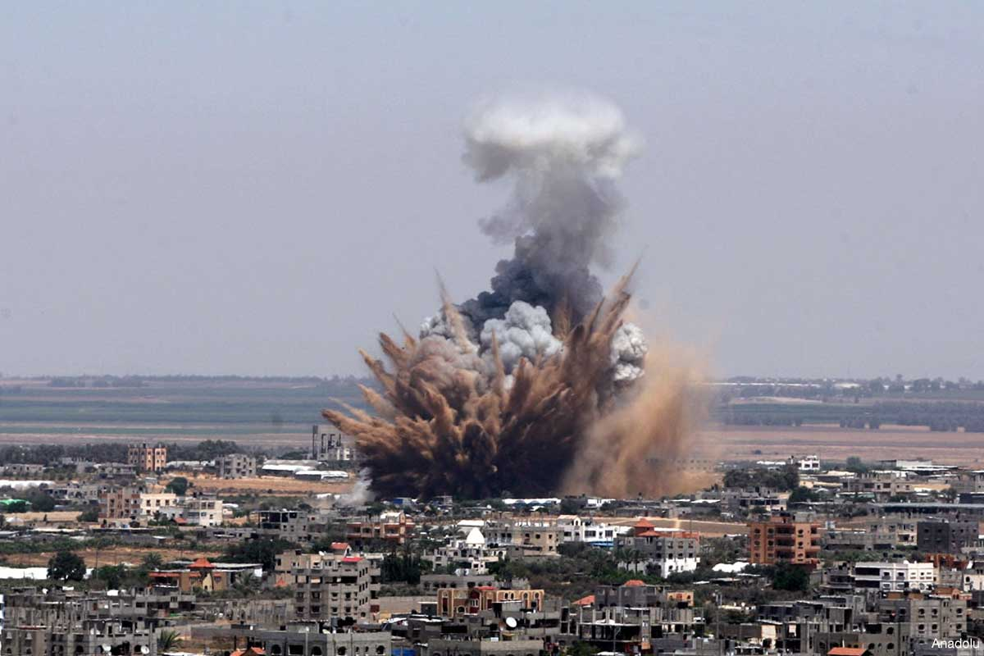
2008-2009:
OPERATION
CAST LEAD
2012:
OPERATION
PILLAR OF CLOUD
2014:
OPERATION
PROTECTIVE
EDGE
Notes:
hospitals, schools, and housing are targeted
this tactic of air warfare is so common that the israelis refer to it as “mowing the lawn”

Slide 47
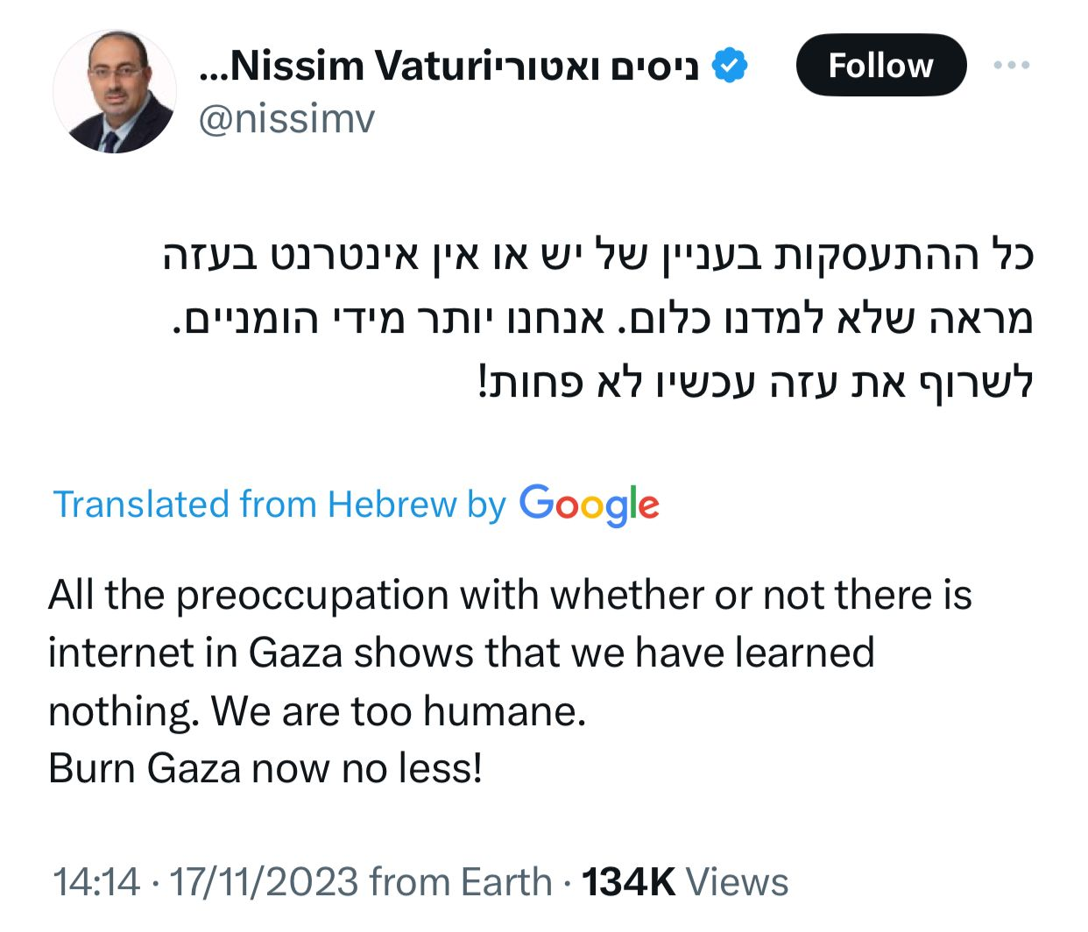
ISRAEL IS COMMITTING GENOCIDE
Since 7 October in Gaza, Israel has:
killed 25,000 Palestinians, 40% of whom children
dropped 6,000 bombs per week
destroyed at least 60% of all homes
destroyed 23 of 36 hospitals, including every hospital in north Gaza
displaced 1.9 million Palestinians (82% of the population of Gaza)
refused to let in aid, including food, causing mass starvation
Deputy Speaker of the Knesset (Israeli Parliament)

Slide 48
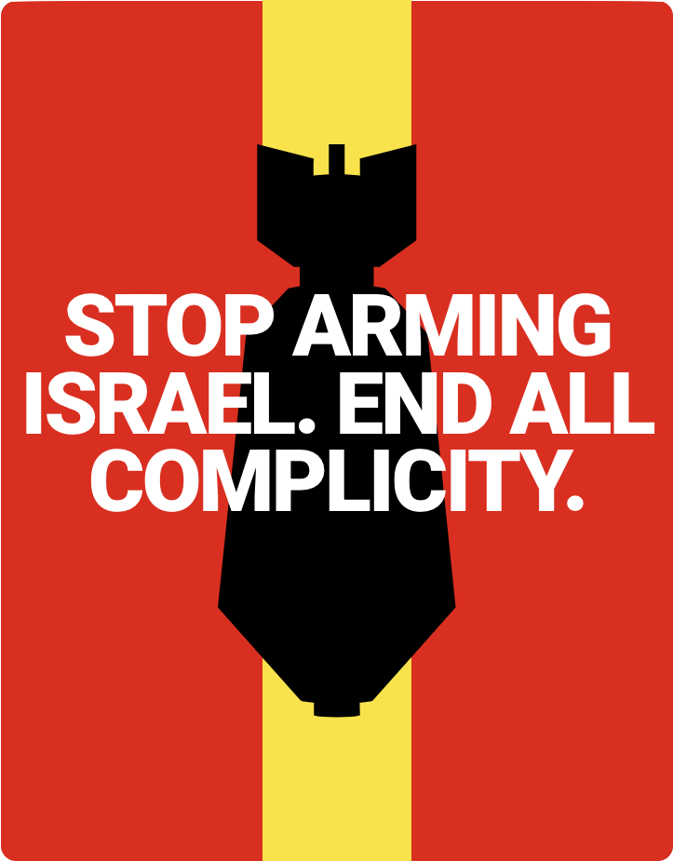
CALL FROM PALESTINIAN TRADE UNIONS

Slide 49
WHAT THE LABOR MOVEMENT CAN DO
Listen to the Palestine Trade Union Calls: END all complicity and stop arming Israel
Refuse to build weapons for Israel
Refuse to transport weapons to Israel
Pass motions and resolutions in your own trade union
Pressure governments to stop funding the Israel Defense Force and/or military trade with Israel
Support YALL’s resolution at AFL-CIO COPE
https://www.workersinpalestine.org/the-calls-languages/english
Notes:
ADD QR CODE for this link: https://forms.gle/pno3apyemDZZHm6z6

Slide 50
WHAT ELSE YOU CAN DO
Listen to and center Palestinian voices
Diversify your media and prioritize news outlets sharing information from the ground in Gaza and the West Bank
Follow Palestinian movements on Social Media
Join community efforts to demand a ceasefire
There are efforts to pass ceasefire resolutions at local city councils in Austin, San Antonio, Houston, and Dallas
Support the Boycott, Divest and Sanction (BDS) movement
Don’t cross the picket line!
Notes:
ADD QR CODE for this link: https://forms.gle/pno3apyemDZZHm6z6

Slide 51
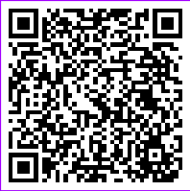
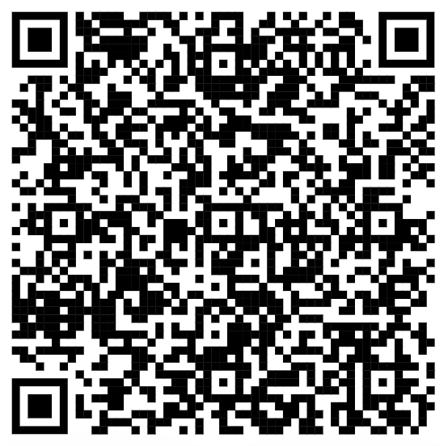
YALL RESOLUTION
FURTHER RESOURCES
Notes:
ADD QR CODE for this link: https://forms.gle/pno3apyemDZZHm6z6

Slide 52
FURTHER RESOURCES:
PYM: www.pymusa.com
BDS MOVEMENT: www.bdsmovement.net
VISUALIZING PALESTINE: www.visualizingpalestine.org
INSTITUTE FOR PALESTINE STUDIES: www.palestine-studies.org
BADIL Resource Center for Palestinian Refugee Rights: www.badil.org
PALESTINE LAND SOCIETY: www.plands.org
Palestine Remix

Slide 53
This presentation was made by the Palestinian Youth Movement
For more information:
pymusa.com
facebook.com/pal.youth.movement
twitter.com/pym_usa
instagram.com/palestinianyouthmovement

Slide 54
Background: Palestine
Notes:
What’s been happening in Palestine didn’t start 2 weeks ago. It is the result of 75 years of Zionist colonisation in Palestine. We need to understand that background to understand the moment that we’re in.
there’s a lot to cover, we’re going to give the high notes
if folks have specifics they want to dive into, we can do that in the questions and we’ll also be sharing out a resource guide to learn more!
you can’t understand what is happening in Palestine today without understanding Zionism, so we’re going to start there.

Slide 55
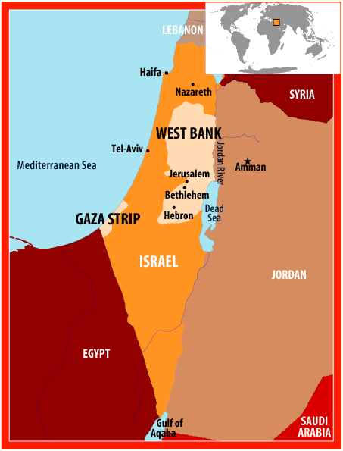
WHERE
ARE WE?

Slide 56
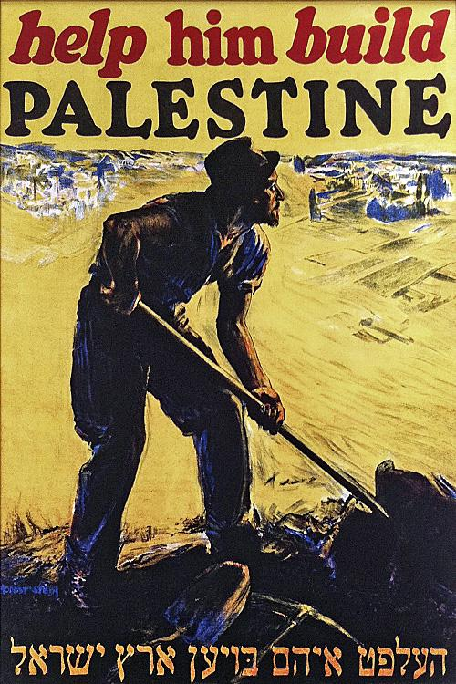
WHAT IS
SETTLER COLONIALISM?
“Both colonialism and settler colonialism are premised on exogenous domination, but only settler colonialism seeks to replace the original population of the colonized territory with a new society of settlers (usually from the colonial metropole). This new society needs land, and so settler colonialism depends primarily on access to territory. This is achieved by various means. … [I]n a settler society ..., colonialism could not be described or theorized in the past tense—there was no “postcolonial.” In these places, the state maintained a colonial relationship with the indigenous peoples (and was complicit in their ongoing dispossession) … [S]ettler colonialism is premised on occupation and the elimination of the native population, while colonialism is primarily about conquest. … [S]ettler colonialism is a structure rather than an event. In this sense, settler colonialism does not really ever ‘end.’”

Slide 57
QUALITIES OF
SETTLER COLONIALISM
Conquest not migration
Founding of political order that forwards sovereignty
Removal to establish new and “better” polity
Settler economic development is structurally opposed to dynamics of colonial de-development
Settler-Native Relationship One of Dispensability (Logic of Elimination)
Opposed to Indispensability and/or Master-Servant dynamic in Colonial context
Settler Colonialism is a structure, not an event
Institutionalized settler privilege
Settler-native distinction in legal and social structures (especially in relation to frontier)
Predominance of individual/private over state-centered activities
Conversely, state promotion and organization of settler activity

Slide 58
SETTLER COLONIALISM’S LOGIC OF ELIMINATION
Confrontation
Massacres
Executions/assassinations
War
Carceration
Forced removal
Reservations/bantustans
Environmental changes
Assimilation
Renaming
Appropriation of culture
Rejection of culture/identity
“Logic of elimination” refers to the many different tactics and strategies used to dispossess indigenous people of their territories.

Slide 59
APARTHEID BROKEN DOWN
Apartheid involves:
(1) inhuman acts committed
(2) for the purpose of establishing and maintaining domination
(3) by one racial group of persons
(4) over any other racial group of persons and
(5) systematically oppressing them

Slide 60
APARTHEID IN PALESTINE
Denial of the:
Right to life by murder of members of a racial group
Right to life and liberty of person by subjection to torture or to cruel, inhuman, or degrading treatment or punishment
Right to liberty of person by arbitrary arrest and illegal imprisonment of members of a racial group
Right to freedom of movement
Right to freedom of residence**
Right to leave and to return to one’s country; Right to a nationality
Right to work; Right to form recognised trade unions
Right to education; Right to freedom of opinion and expression
[no denial] Imposition on a racial group of living conditions calculated to cause its physical destruction in whole or in part
… [list goes on]

Slide 61
Discussion Activity
As we saw, Zionist leaders have historically understood the Zionist project as colonial, and they have discussed it openly as a colonial/imperial project. Today, why do you think there is a tendency amongst Zionists to deny the colonial nature of the Israeli state project?
Why is it important that we assert our struggle as one specifically against colonialism?
How can we strategically do this in our own location or community?

Slide 62
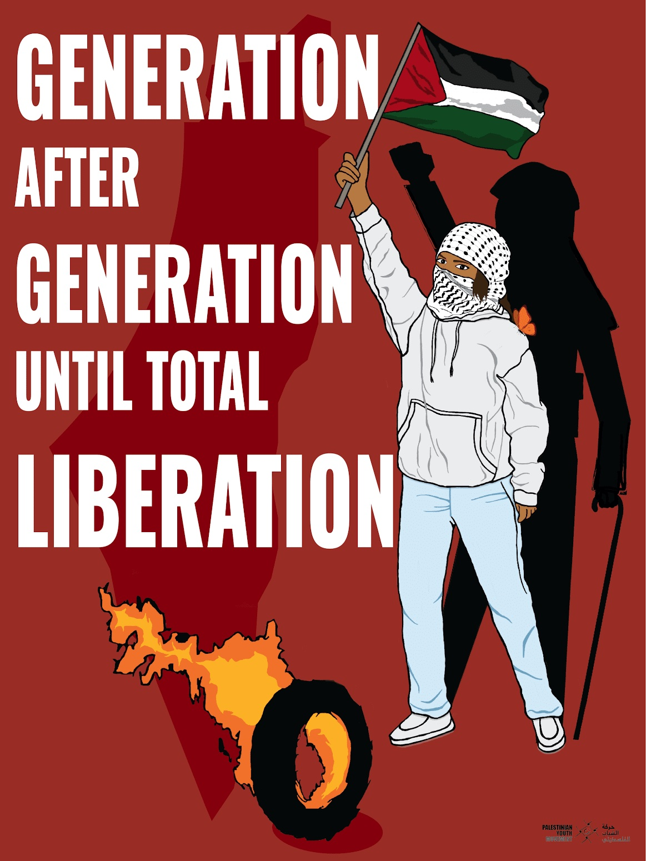
HISTORICAL CONTEXT
Notes:
build off of previous points on zionism
place into larger context, dynamics

Slide 63
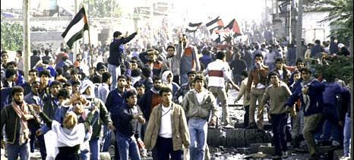
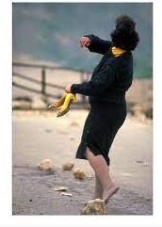
FIRST INTIFADA, 1987-1993
Notes:
run thru

Slide 64
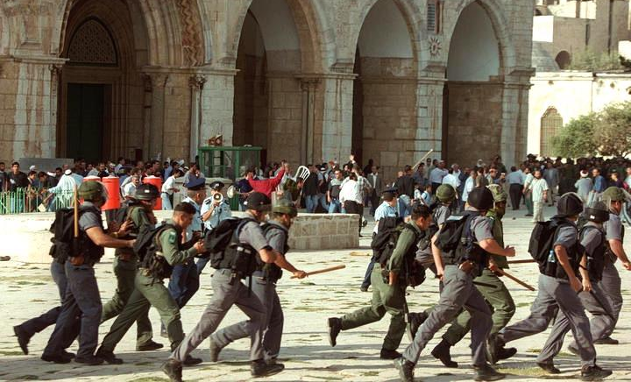
SECOND INTIFADA, 2000-2005

Slide 65
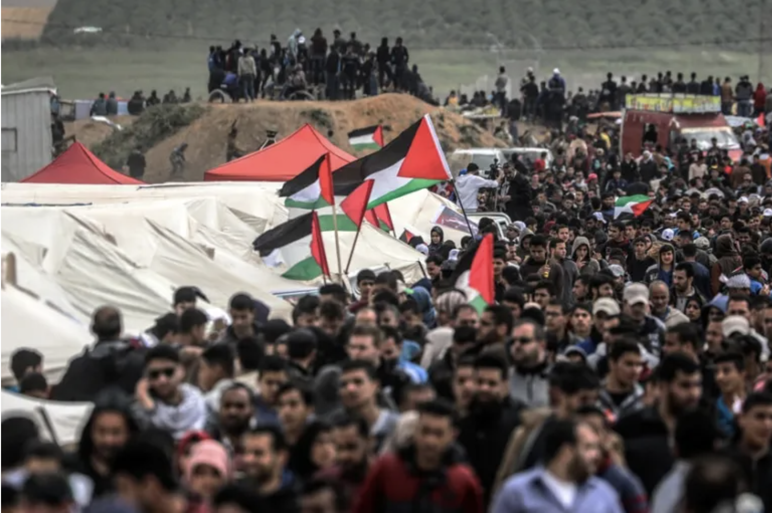
GREAT MARCH OF RETURN, 2018

Slide 66
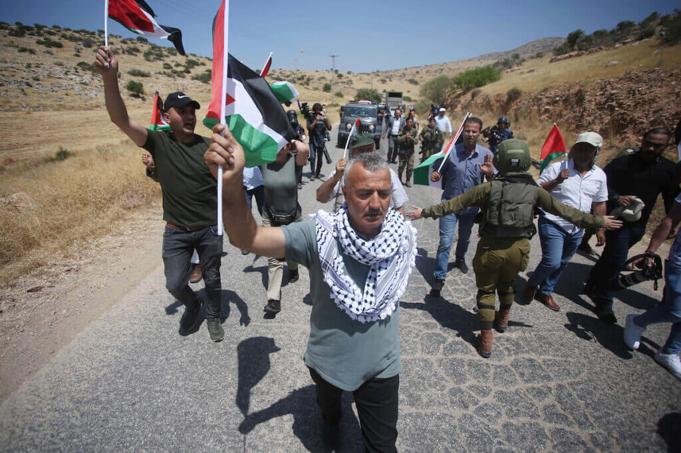
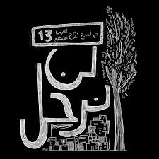
UNITY UPRISINGS, 2021

Slide 67
THE MANY FACES OF ZIONIST SETTLER COLONIALISM
GAZA: punitive 16 year siege by land, water, and air; restriction of food, electricity, water, construction materials; regular genocidal air strikes
REFUGEES: continued refusal of right of return; attempts to dissolve refugee “problem” (Deal of the Century)
DIASPORA: restrictions on right to protest, doxxing, threats, anti-Arab racism & Islamophobia
‘48 PALESTINE: legalized discrimination, forced assimilation, “enemy within”, ghettos, poverty; until 1966, under martial law
WEST BANK: control of movement, land confiscation, annexation wall, settler violence, restrictions on construction, home demolitions, collective punishment
Notes:
brief overview of the many facets of zionist settler colonialism in Palestin

Slide 68
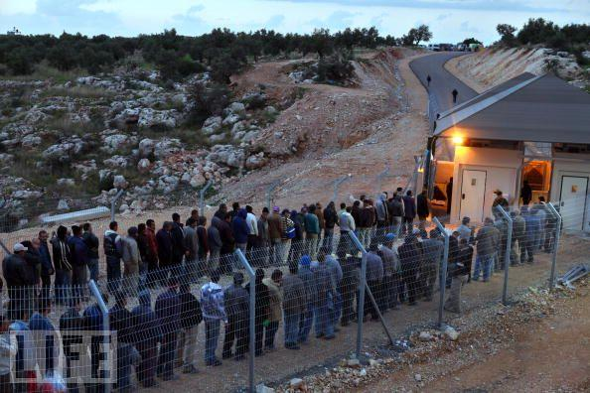
INFRASTRUCTURE OF OCCUPATION
CHECKPOINTS: control Palestinian life, freedom of movement
SETTLEMENTS: confiscation of land and settler violence
WALL: fragmentation, limits freedom of movement, land confiscation

Slide 69
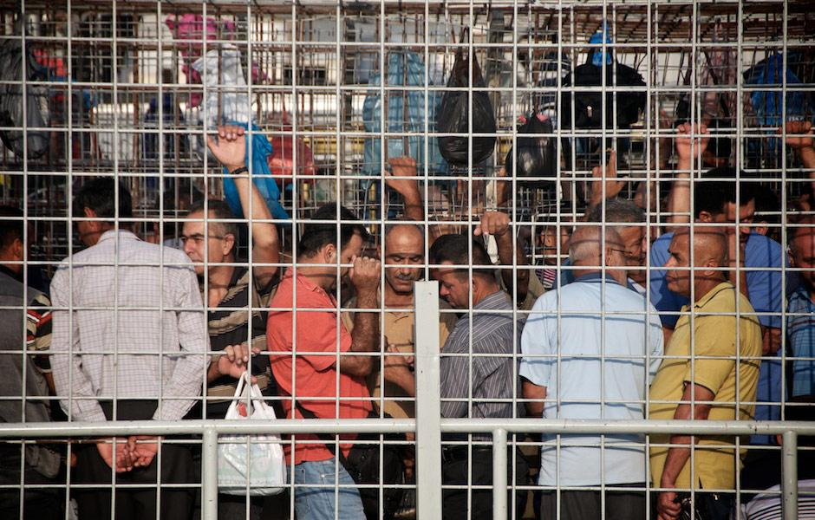
CHECKPOINTS

Slide 70
DENIAL OF FREEDOM OF MOVEMENT
Checkpoints and Roadblocks
522+ different forms of restrictions to physical movement
Restrict movement between Palestinian territories and within territories
70 Palestinian villages are compelled to use detours that take about 5-7 times longer than a direct route
Permit System
Palestinians must carry IDs at all time that dictate where they can travel
Palestinians must acquire permits to travel between Palestinian Territories
Different permits must be acquired for different needs- health care, access to maintain agricultural land, access to go to work, etc.

Slide 71
SETTLEMENTS
Notes:
purpose of settlements is land grabs
illegal under international law

Slide 72
WALL

Slide 73
SEPARATE & UNEQUAL ROADS

Slide 74
OTHER TACTICS OF ZIONISM
Denial of freedom of movement (checkpoints, id system)
Denial of freedom of residence
Separate and unequal infrastructure
Home demolitions
Administrative detention: indefinite detention without charge or trial, often without access to lawyer or family
Children are also subjected to arrest and imprisonment and tried through military courts with > 99% conviction rate
Notes:
residence:
Many Arab and Bedouin villages are considered “unrecognized” and therefore illegal.
Since 1948, 1000 Israeli villages (as of 2010) havereceived recognition, while 0 (zero) Palestinian villages have been established, despite 7x increase in Palstinian population.

Slide 75
GAZA: SIEGE AND COLLECTIVE PUNISHMENT
Notes:
The people of Gaza shoulder the largest burden for our collective liberation, they are the greatest victims, but also the greatest heroes
No amount of collective punishment by the Zionist entity will bend or break the will of our people to live in dignity and freedom.

Slide 76
DEMOGRAPHIC ENGINEERING
FOLLOWING THE NAKBA
Israeli Laws and Policies following 1948
Absentee Property Law - “absentees” forfeit their land and property;
the definition of "absentee" in the law was framed in such a way as to ensure that it applied to every Palestinian or resident in Palestine who had left his/her usual place of residence in Palestine for any place inside or outside the country after the adoption of the partition of Palestine resolution by the UN;
Israel’s Law of Return: The Law of Return is Israeli legislation, passed on 5 July 1950, which gives Jews the right of return and the right to live in Israel and to gain Israeli citizenship.
Prevention of Infiltration Law
“When I come now to Jerusalem, I feel I am in a Jewish(Ivrit) city. This is a feeling I only had in Tel-Aviv or in an agricultural farm. It is true that not all of Jerusalem is Jewish, but it has in it already a huge Jewish bloc: when you enter the city through Lifta and Romema, through Mahaneh Yehuda, King George Street and Mea Shearim - there are no Arabs. One hundred percent Jews. Ever since Jerusalem was destroyed by the Romans - the city was not as Jewish as it is now. In many Arab neighbourhoods in the West you do not see even one Arab. I do not suppose it will change. And what happened in Jerusalem and in Haifa - can happen in large parts of the country. If we persist it is quite possible that in the next six or eight months there will be considerable changes in the country, very considerable, and to our advantage. There will certainly be considerable changes in the demographic composition of the country.”
Ben Gurion reporting to Mapai Council in Jerusalem, February, 1948
Notes:
run thru - 10 seconds

Slide 77
NAKSA, 1967
ANNEXATION AND OCCUPATION
Notes:
within less than 30 years, a massiv wave of Palestinians are again displaced and made stateless and homeless

